Slide 1

Lecture 13. Kinetics of rapid coagulation.
Сoagulation
Smoluchowski gave the quantitative characteristics to coagulation.
Monodisperse system
Spherical shape particles
Coagulation as bimolecular reactions, each collisions are effective.
Coagulation is diffusion controlled process
Rapid coagulation – no repulsive barrier.
Adilbekova A.O

Slide 2
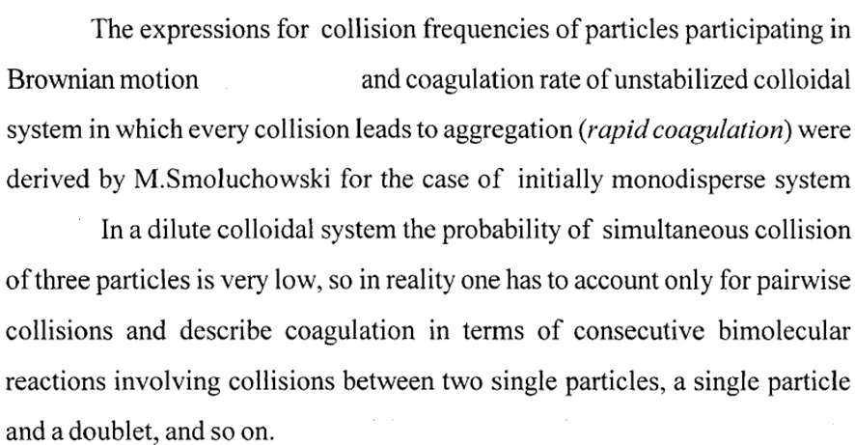

Slide 3
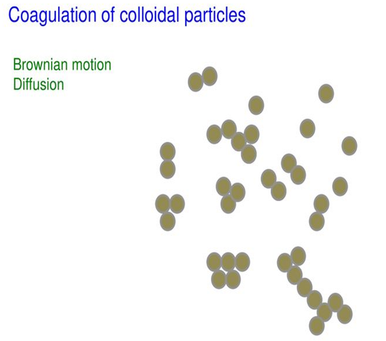
https://slideplayer.com/slide/12979348/

Slide 4
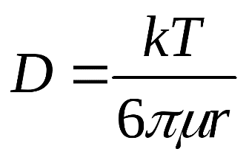
-dv/dt = 8πdDv²
d – is a distance between particles
ν – concentration of particles
D – coefficient od Diffusion
-dv/ dt = k ν²
k – const of coagulation rate
As reaction of second order
Smoluchowski supposed that all impacts are effective and result with coagulation.
Double, triple and other complex particles exit.
Integrating on ν₀ to ν and t₀ to t
ν = ν₀/ (1+t/θ)
θ = t when ν = ν₀/2

Slide 5
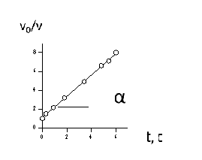
θ = 1/k ν₀
θ = 3η/8kT υ₀
v = v₀/ (1+t/θ)
v₀/v = 1 + t/ θ (linear form)
θ – time of half coagulation
or coagulation of half number of particles
ctg α = θ
k = k_{r}Pexp (- ΔE/k_{b}T)
k_{r} = 8К_{b}T/3η, k_{r} - const of rapid coagulation

Slide 6
Total concentration of particles
Independence of particles number on time at the rapid coagulation

Slide 7
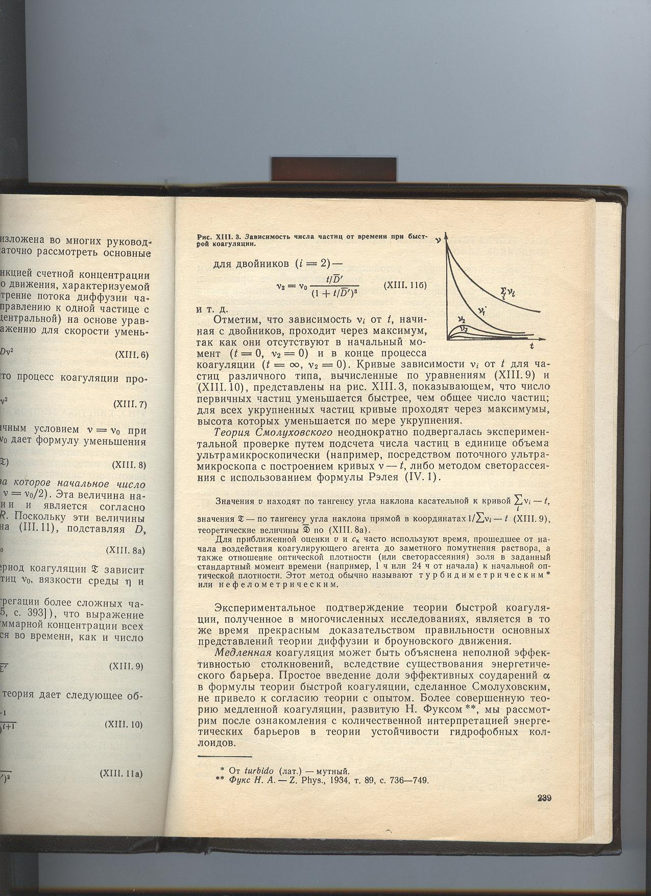
Dependence of particles number on time at the rapid coagulation

Slide 8
Questions?
Thank you for your attention!
Akbota.Adilbekova@kaznu.kz

